Slide 1
INTRODUCTION TO DEEP LEARNING AND ITS APPLICATIONS
TAMIL SELVI K
ASSISTANT PROFESSOR / CSE
KONGU ENGINEERING COLLEGE

Slide 2


Slide 3
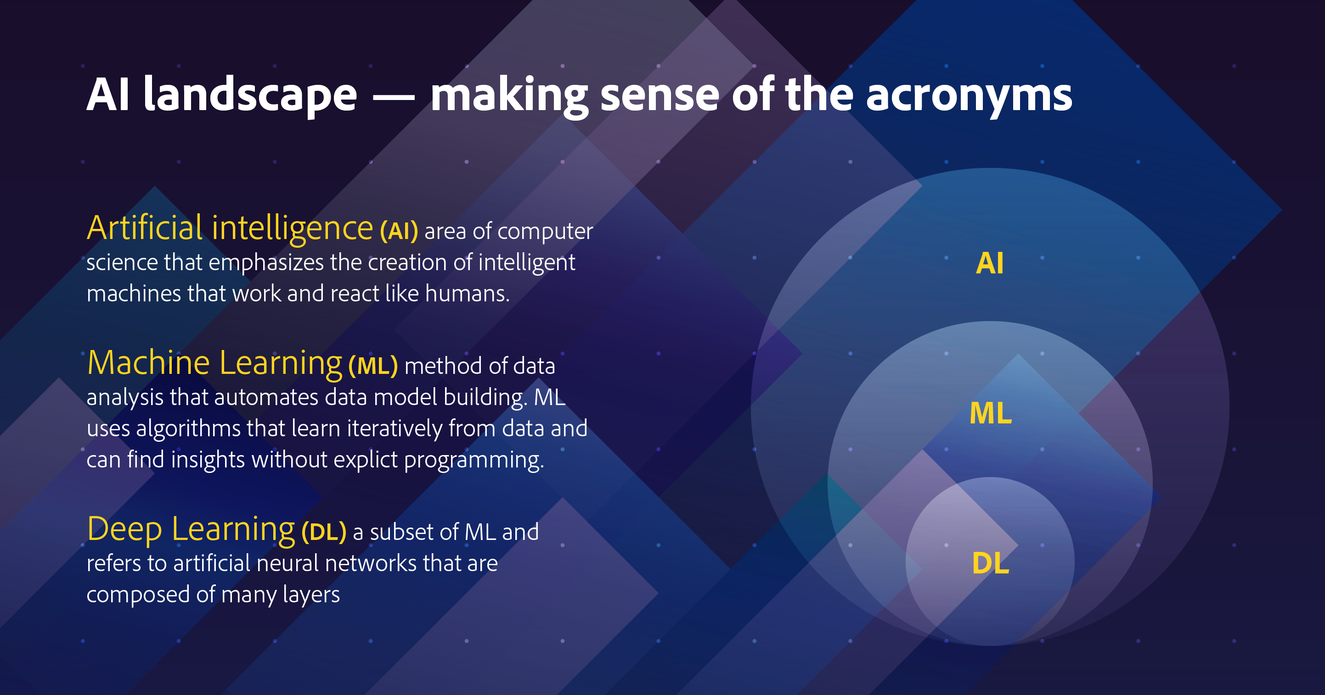

Slide 4
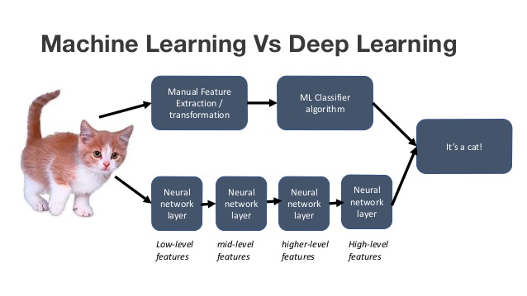
Machine Learning vs Deep Learning

Slide 5


Slide 6
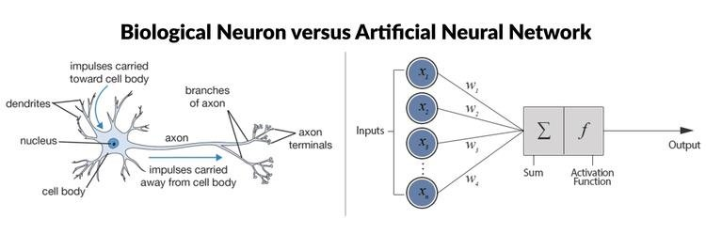

Mapping b/w biological and artificial neuron

Slide 7
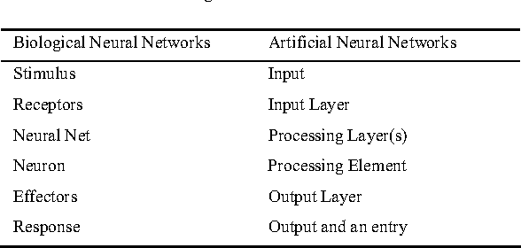
Biological Neuron Vs Artificial Neuron

Slide 8
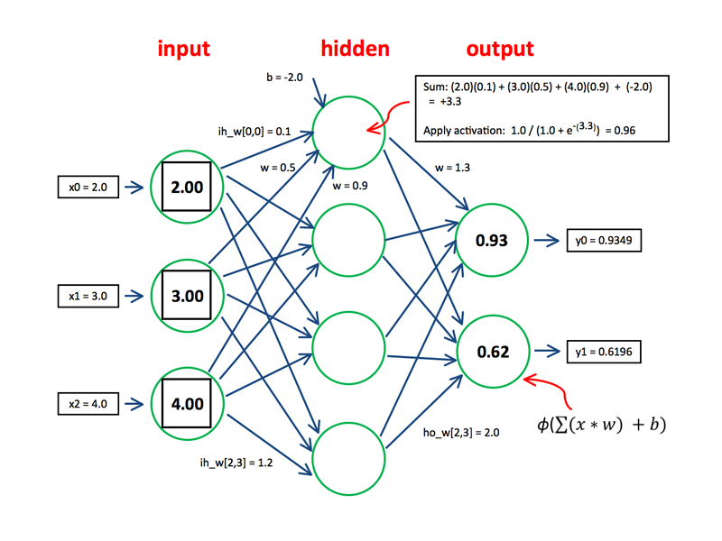
Neural Network – Input – Process – Output Mechanism

Slide 9
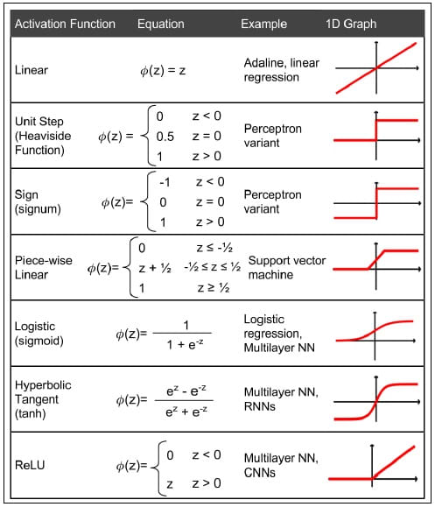
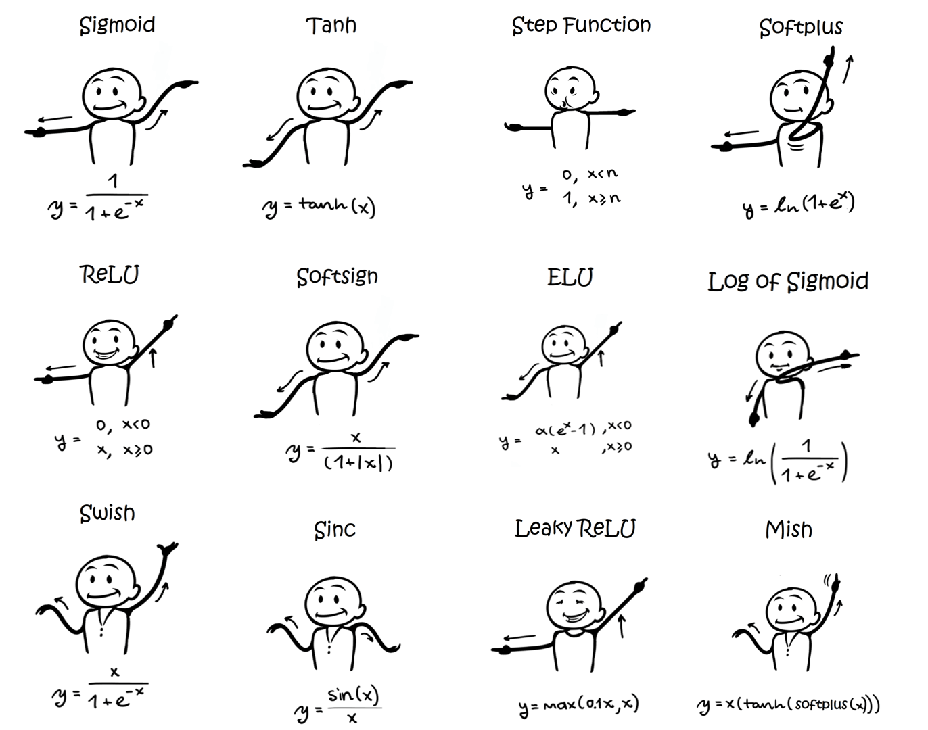
Activation Functions

Slide 10
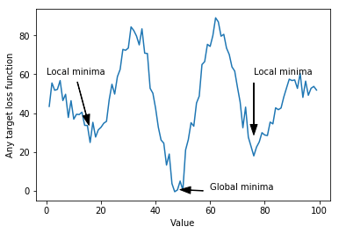
Weights and Bias
Weight increases the steepness of activation function, this means weight decide how fast the activation function will trigger whereas bias is used to delay the triggering of the activation function.

Slide 11
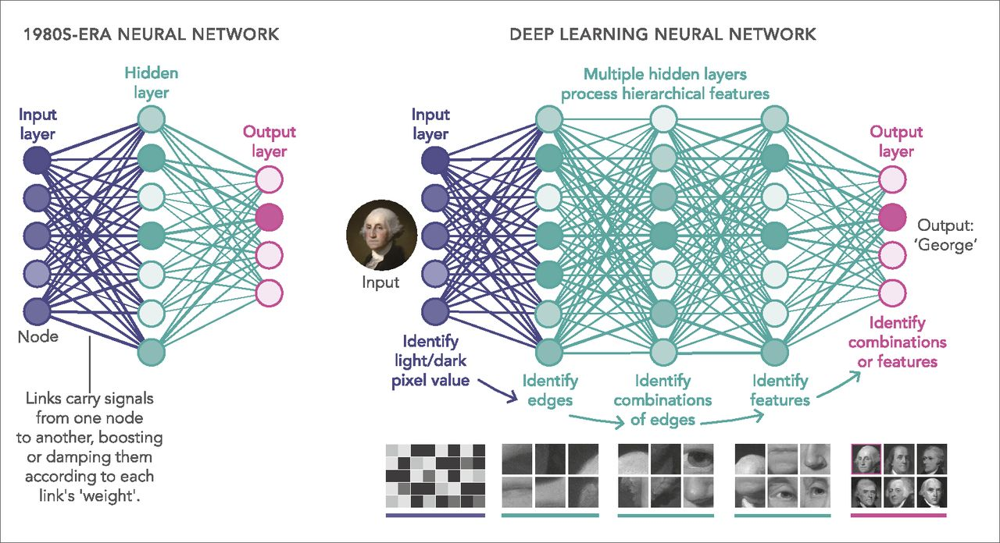

Slide 12

Types of Deep Neural Networks

Slide 13
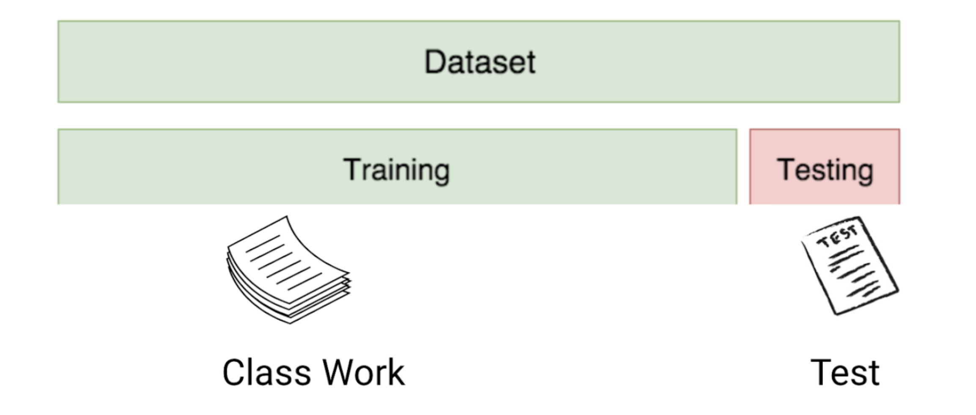
Basic jargons of Deep Learning parameters
Training set
A training set is a group of sample inputs you can feed into the neural network in order to train the model. The neural network learns your inputs and finds weights for the neurons that can result in an accurate prediction.
Training error
The error is the difference between the known correct output for the inputs and the actual output of the neural network. During the course of training, the training error is reduced until the model produces an accurate prediction for the training set.

Slide 14
Basic jargons of Deep Learning parameters (contd.,)
Validation set / Test set
A validation set is another group of sample inputs which were not included in training and preferably are different from the samples in the training set. This is a “real life exercise” for the model: can it generate correct predictions for an unknown set of inputs?
Validation error
The nice thing is that for the validation set, the correct outputs are already known. So it’s easy to compare the known correct prediction for the validation set with the actual model prediction—the difference between them is the validation error.

Slide 15
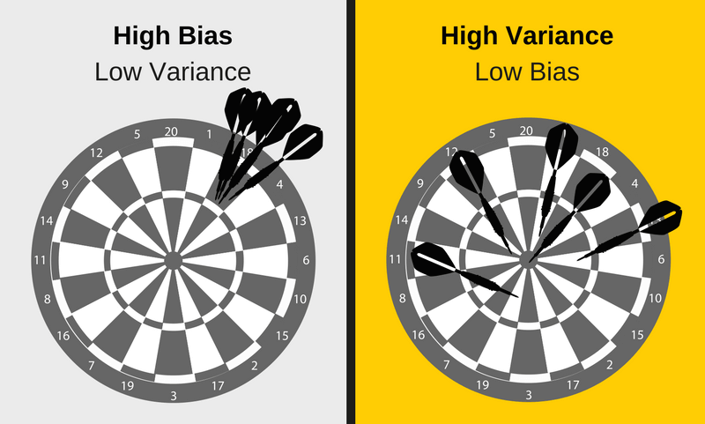
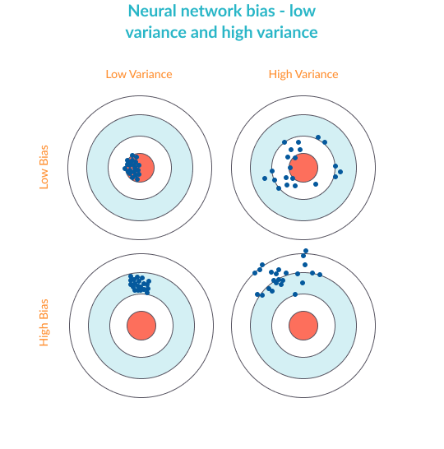
Bias vs. Variance
Bias - high bias means the model is not “fitting” well on the training set. This means the training error will be large. Low bias means the model is fitting well, and training error will be low.
Variance - high variance means that the model is not able to make accurate predictions on the validation set. The validation error will be large. Low variance means the model is successful in breaking out of its training data.

Slide 16
Overfitting and Underfitting
Real Time Analogy
Overfitting is like trying to learn the English language by using a very specific training set. For example, reading all the plays by Shakespeare. Someone who learns the language using only Shakespeare, as an example, will learn a very specialized form of English and may not be able to understand other English text.
To understand underfitting, consider someone who tries to learn English by listening to Seinfeld episodes, but ignoring most of the sentences and using only those that start with common words like “a”, “the”, “I”, etc. This person would have a very limited understanding even of those sentences themselves, not to mention a poor ability to understand English text in general.

Slide 17
Overfitting in Neural Networks
Overfitting happens when the neural network is very good at learning its training set, but cannot generalize beyond the training set (known as the generalization problem).
The symptoms of overfitting are:
Low bias accurate predictions for the training set
High variance poor ability to generate predictions for the validation set

Slide 18
Underfitting in Neural Networks
Underfitting happens when the network is not able to generate accurate predictions on the training set.
The symptoms of underfitting are:
High bias
Low Variance

Slide 19
Exercise
Identify underfitting and Overfitting

Slide 20
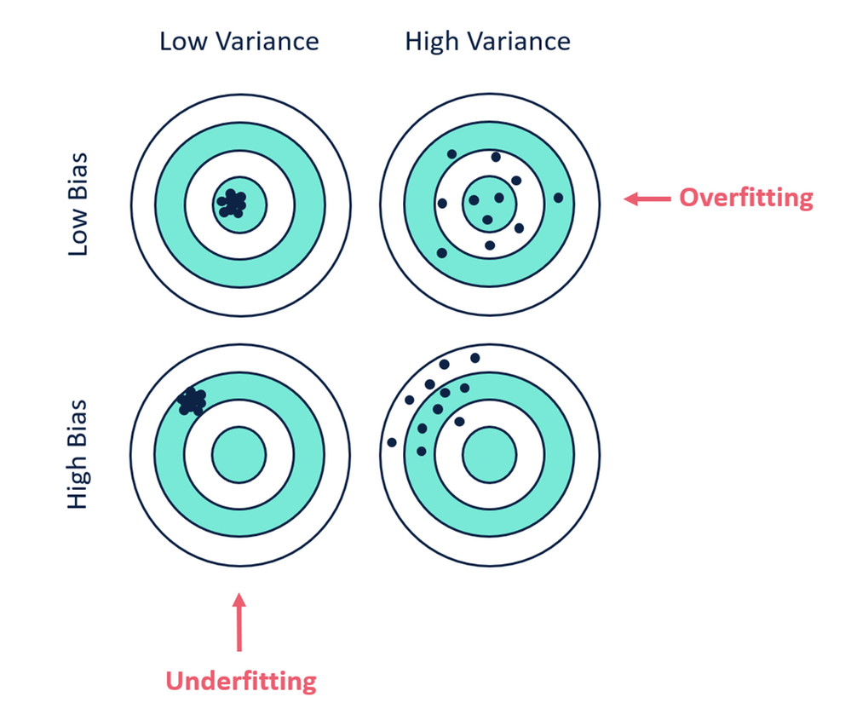
Solution

Slide 21
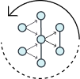
Methods to Avoid Overfitting in Neural Networks
The following are common methods used to improve the generalization of a neural network, so that it provides better predictive performance when applied to the unknown validation samples. The goal is to improve variance.
1. Retraining Neural Networks
Running the same neural network model on the same training set, but each time with different initial weights. The neural network with the lowest performance is likely to generalize the best when applied to the validation set.

Slide 22
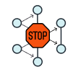
Methods to Avoid Overfitting in Neural Networks (Contd.,)
2. Early Stopping
Divide training data into a training set and a validation set and start training the model. Monitor the error on the validation set after each training iteration. Normally, the validation error and training set errors decrease during training, but when the network begins to overfit the data, the error on the validation set begins to rise.
Early stopping occurs in one of two cases:
If the training is unsuccessful, for example in a case where the error rate increases gradually over several iterations.
If the training’s improvement is insignificant, for example, the improvement rate is lower than a set threshold.

Slide 23
Methods to Avoid Overfitting in Neural Networks (Contd.,)
3. Regularization
Regularization is a technique which makes slight modifications to the learning algorithm such that the model generalizes better. This in turn improves the model’s performance on the unseen data as well.
L2 & L1 regularization (Cost function = Loss (say, binary cross entropy) + Regularization term)
----- Weight decreases, model simpler, reduce overfitting
Dropout
------ At every iteration, it randomly selects some nodes and removes them along with all of their incoming and outgoing connections
4. Data augmentation
----- to make the training dataset more diverse

Slide 24
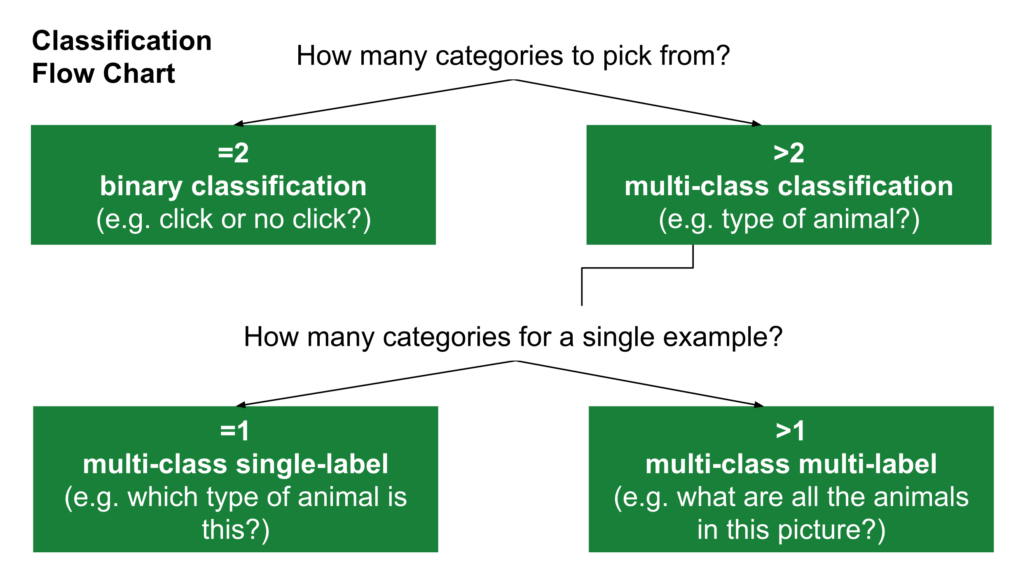

Slide 25
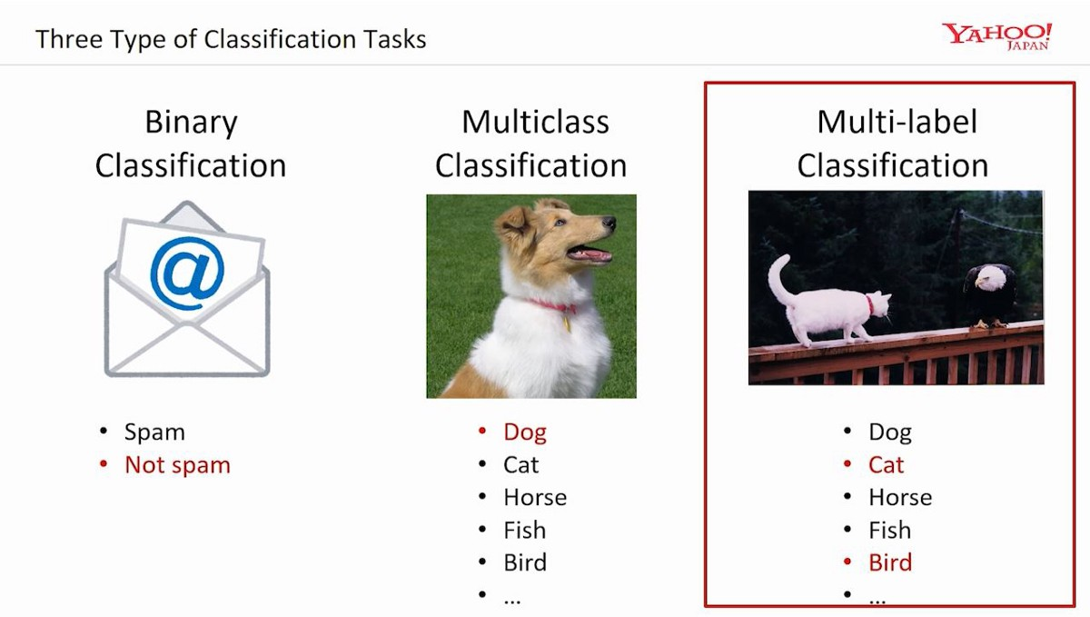
Illustrations

Slide 26
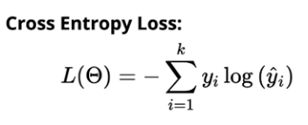
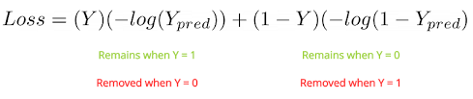
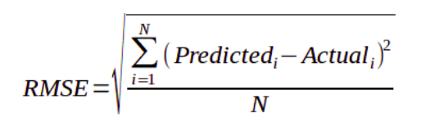
Loss Functions

Slide 27
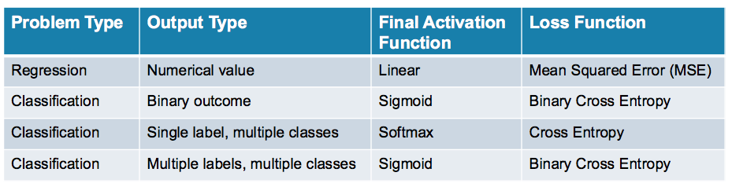
Loss Functions for Classification tasks

Slide 28
